Slide 1

Analyzing The Impact of Car Features on Price and Profitability
By Satyashree Sahu Pawar

Slide 2
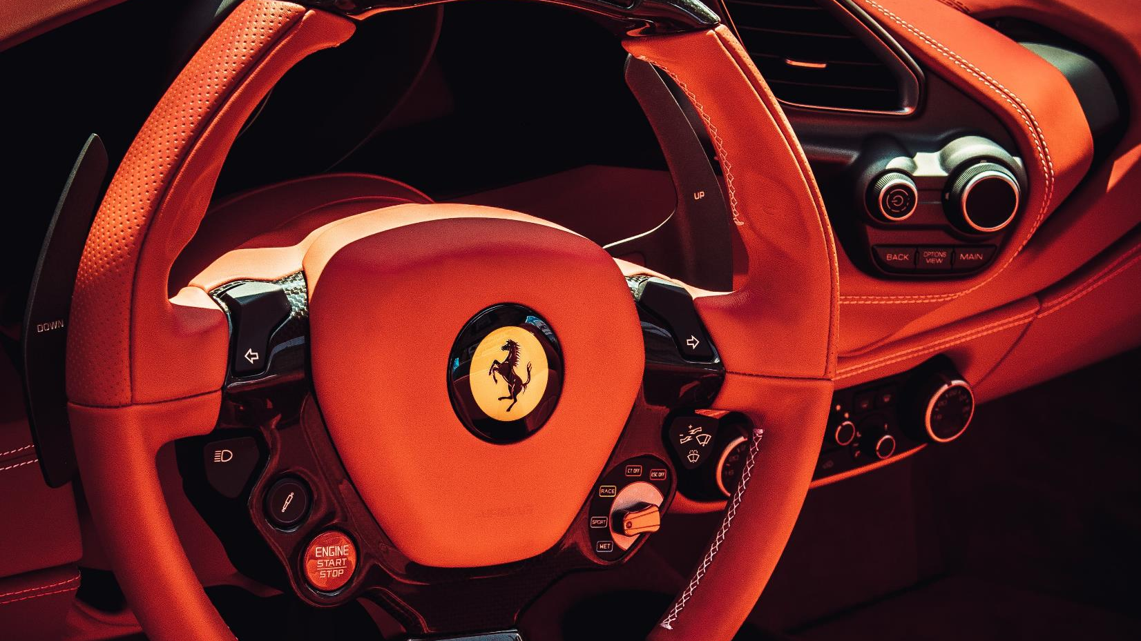
Content
Insights
Insights
Results
Tech-Stack Used
3
Approach
Approach
Project Description
1

Slide 3

Project Description
This data analysis project aims to guide a car manufacturer in optimizing pricing and product development decisions to enhance profitability and meet consumer demand in The rapidly evolving automotive industry. By leveraging a comprehensive dataset encompassing car features, market categories, pricing, and sales data, The analysis will employ techniques such as exploratory data analysis, regression analysis, market segmentation, and competitive analysis. The goal is to identify influential factors affecting pricing, understand consumer preferences, and determine The most profitable market segments. Through this data-driven approach, The manufacturer will be equipped to develop a balanced pricing strategy that aligns with consumer demand while maximizing profitability. The findings will also guide future product development efforts by highlighting key features that resonate with consumers and contribute significantly to profitability. Continuous monitoring and adaptation strategies will be recommended to ensure The manufacturer remains competitive in The dynamic automotive landscape.

Slide 4



Tech-stack Used
Link to Excel File
Microsoft Excel 365
Data Cleaning
Data Analysis
Visualization
Dashboard
Microsoft PowerPoint 365
Presentation

Slide 5
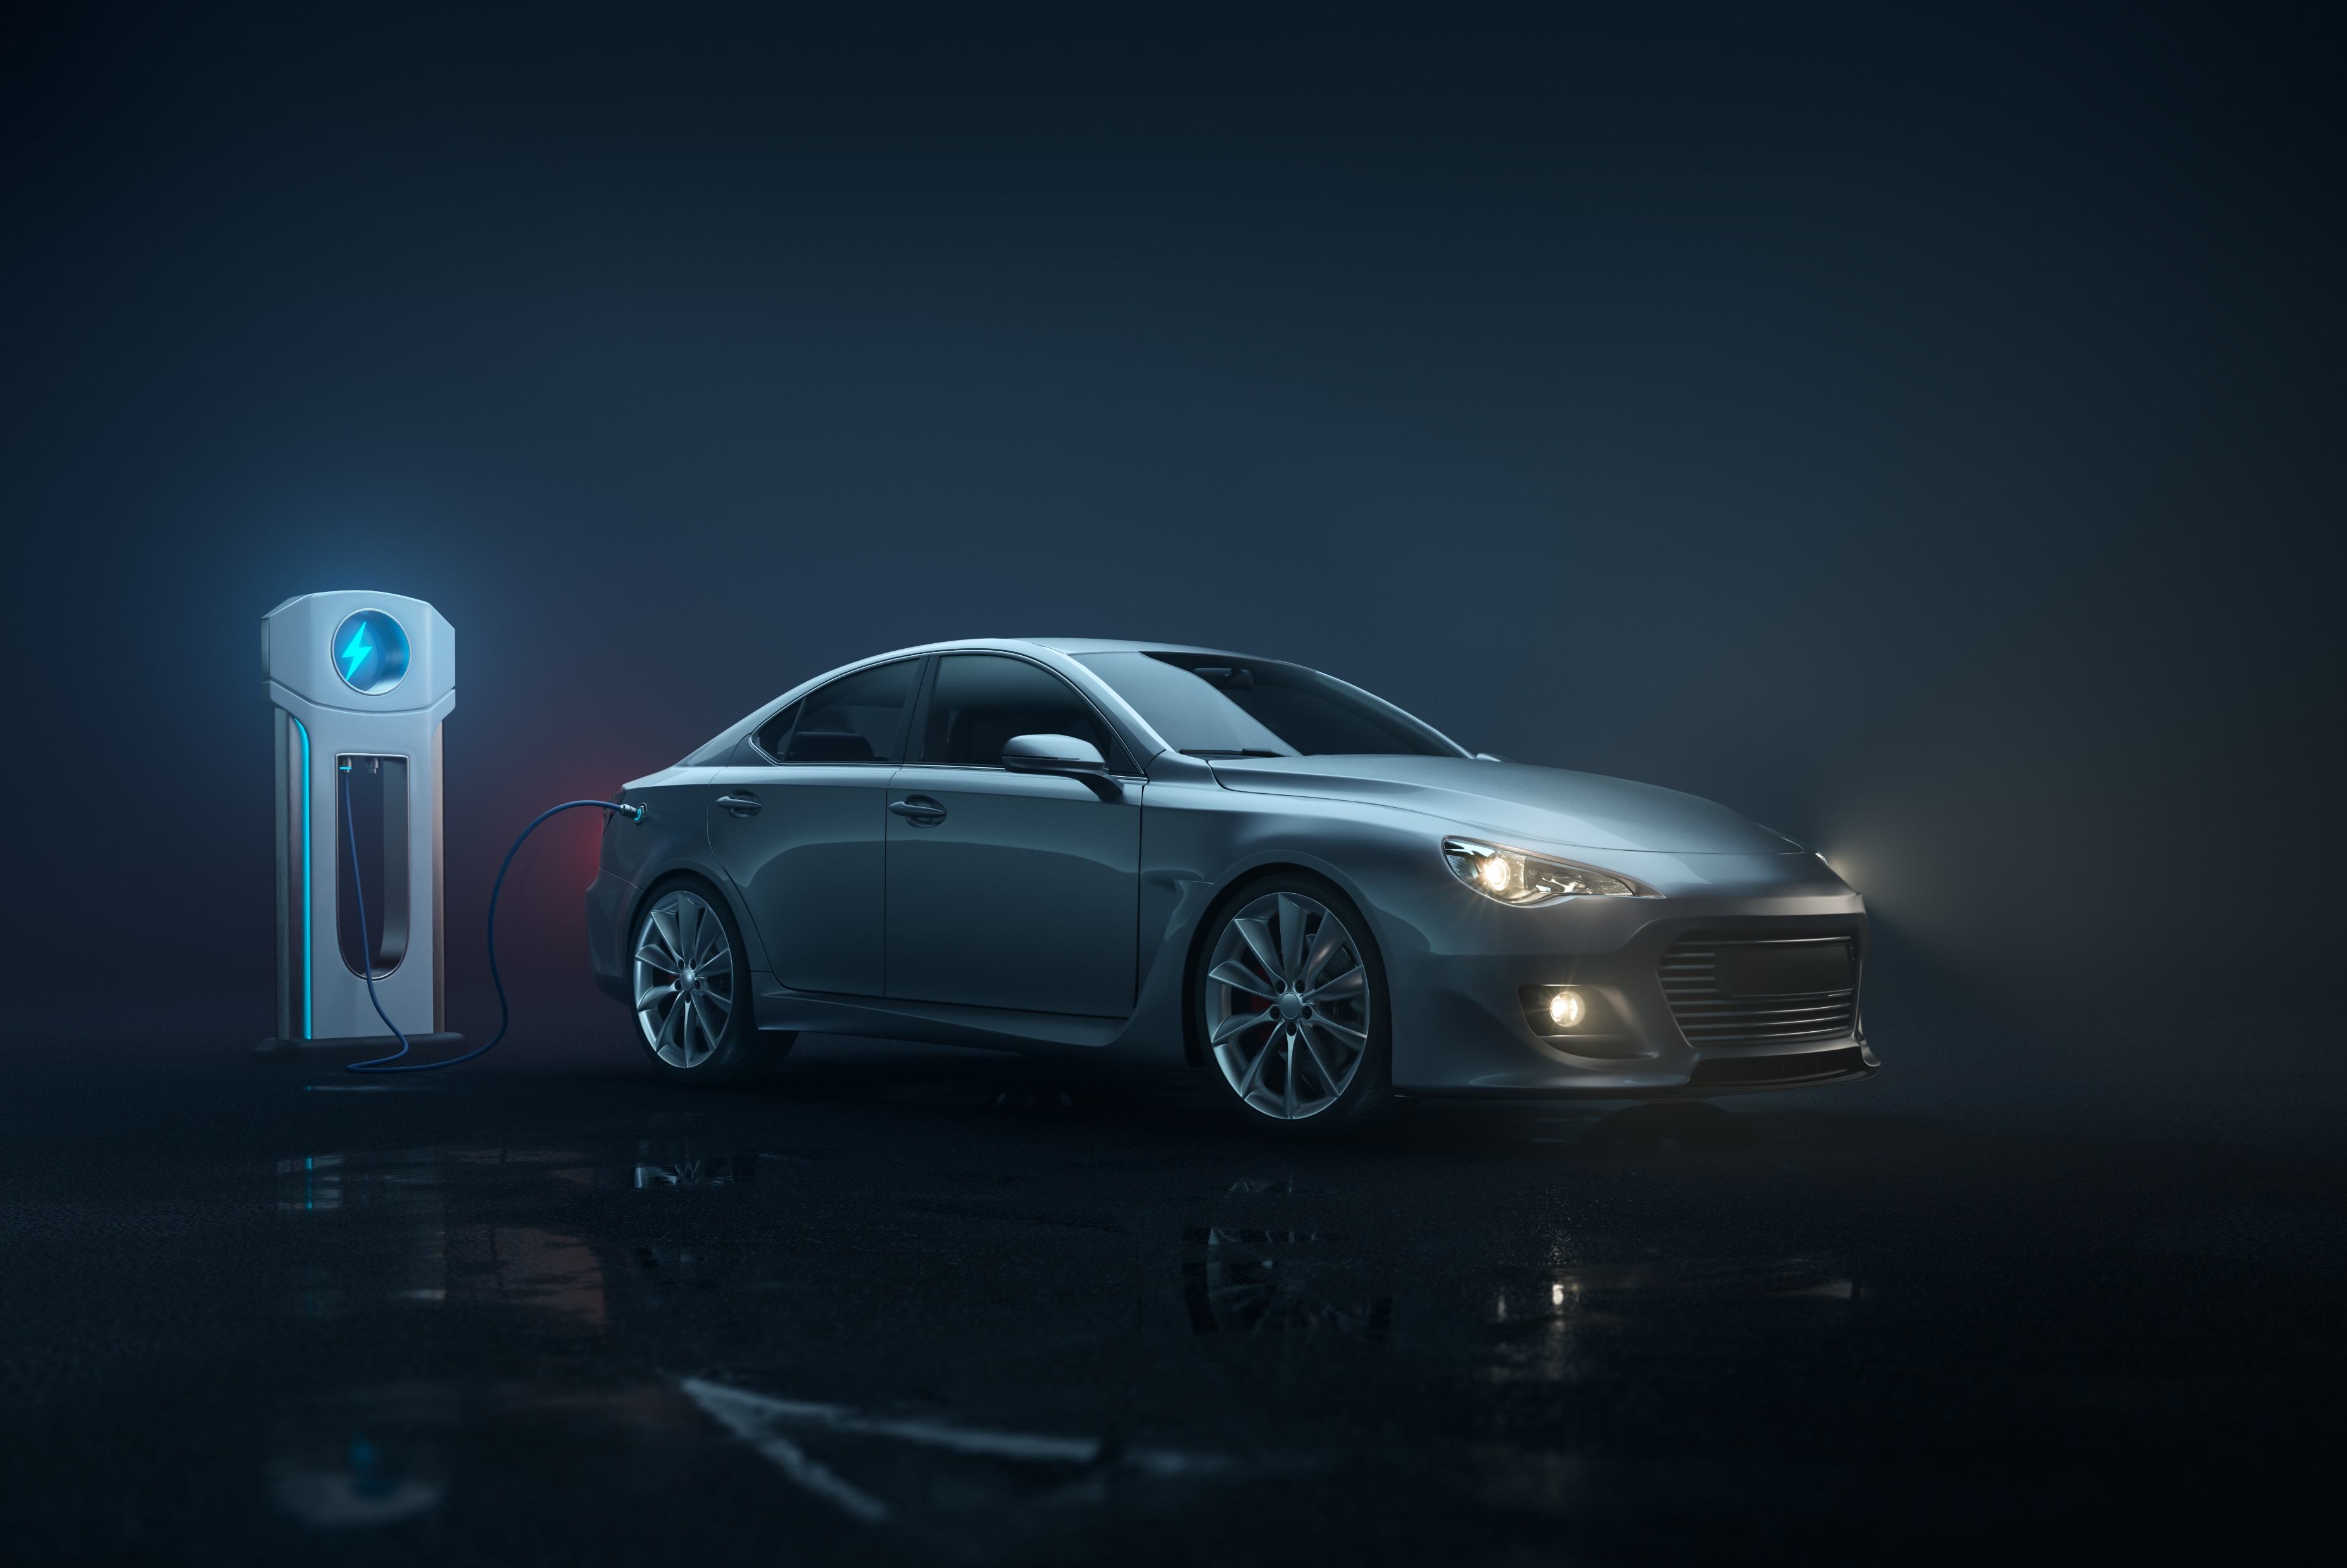
Approach
1
Understanding
Understanding The data, features it contains, meaning behind it & what impact does it have on The target
2
Data Clean
Handling The irregularities in The data such as null/missing values
3
Analyze
Analyzing The data, various relations between The features to derive conclusions
4
Visualize
Visualize The Analysis and create a Dashboard

Slide 6

Understanding Data
The variables in The dataset are:
Make: The car's manufacturer or brand
Model: The specific designation of the car
Year: The production year of the car
Engine Fuel Type: The fuel category utilized by the car (gasoline, diesel, etc.)
Engine HP: The horsepower generated by the car's engine
Engine Cylinders: The count of cylinders within the car's engine
Transmission Type: The method of transmission, categorized as automatic or manual
Driven_Wheels: The wheels powered by the car's engine (front, rear, or all)
Number of Doors: The total count of doors on the car
Market Category: The market segment to which the car belongs (Luxury, Performance, etc.)
Vehicle Size: The dimensions and scale of the car
Vehicle Style: The distinctive style or design of the car (Sedan, Coupe, etc.)
Highway MPG: The anticipated miles per gallon the car achieves on the highway
City MPG: The expected miles per gallon the car achieves in city conditions
Popularity: A ranking of the car's popularity based on the number of views on Edmunds.com
MSRP: The manufacturer's suggested retail price for the car

Slide 7
Understanding Data
Number of Rows
11,914
Number of Columns
16
Car Manufacturer
48
Car Models
11,000

Slide 8
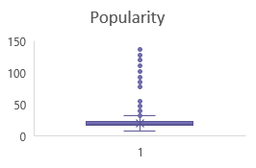
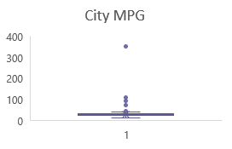
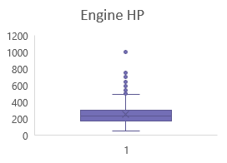
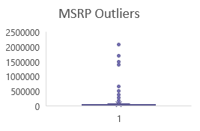
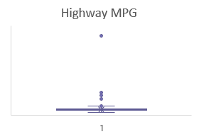
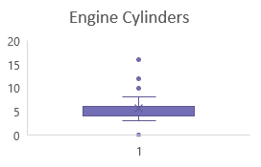
Understanding Data
The outliers present are not removed as :
Removing Outliers from Engine Cylinder(0) would remove all Electric Cars Category as They do not have a Naturally Aspirated Engine, They have Motors.
Removing Outliers from Highway MPG / City MPG would again remove majority of Electric Cars and Hybrids. The outlier in Highway MPG which was at extreme end was removed as it was a petrol car with MPG as 354 which is not possible.
Removing outliers from MSRP would remove almost all The luxury car brands

Slide 9

Data Cleaning
Old Engine Fuel Type | New Engine Fuel Type
diesel | Diesel
electric | electric
flex-fuel (premium unleaded recommended/E85) | Flex-Fuel
flex-fuel (premium unleaded required/E85) | Flex-Fuel
flex-fuel (unleaded/E85) | Flex-Fuel
flex-fuel (unleaded/natural gas) | Flex-Fuel
Gasoline | Gasoline
natural gas | natural gas
premium unleaded (recommended) | Premium Unleaded
premium unleaded (required) | Premium Unleaded
regular unleaded | Regular Unleaded

Slide 10
Data Cleaning
Make | Model | Average of Engine HP | Source
Chevrolet | Impala | 241 | PivotTable
FIAT | 500e | 111 | Online
Ford | Escape | 175 | PivotTable
Ford | Focus | 158 | PivotTable
Ford | Freestar | 199 | PivotTable
Honda | Fit EV | 123 | Online
Kia | Soul EV | 109 | Online
Lincoln | Continental | 288 | PivotTable
Lincoln | MKZ | 228 | PivotTable
Mercedes-Benz | M-Class | 356 | PivotTable
Mitsubishi | i-MiEV | 66 | PivotTable
Nissan | Leaf | 107 | Online
Tesla | Model S | 1000 | Online
Toyota | RAV4 EV | 154 | PivotTable
There are 69 Null Values.
The method used of Imputation was using average HP of already available data for a particular Make and model using pivot table and for The make and model not available, The values from internet search were used.

Slide 11
Data Cleaning
Make | Model | Engine Fuel Type | Count of Engine Cylinders
Chevrolet | Bolt EV | electric | 0
Mazda | RX-7 | Regular Unleaded | 0
Mazda | RX-8 | Premium Unleaded | 0
Mitsubishi | i-MiEV | electric | 0
Toyota | RAV4 EV | electric | 0
Volkswagen | e-Golf | electric | 0
Electric Engines do not have an engine They have motors, hence The number of cylinders is 0.
Mazda’s The models RX-7 & RX-8 use a rotary engine and do not have cylinders hence imputed with 0 again

Slide 12

Insights
Car Model Popularity Across Market Categories:
The interactive dashboard reveals that certain market categories significantly influence The popularity of car models.
Manufacturers should focus on understanding and targeting specific market categories to optimize Their product offerings.
Relationship between Engine Power and Price:
The scatter chart with a trendline demonstrates a positive correlation between engine power and car price.
Consumers may be willing to pay higher prices for cars with more powerful engines, indicating a potential avenue for premium pricing strategies.
Car Features and Price Relationship:
Regression analysis highlights key features impacting car prices, with The bar chart illustrating Their relative importance.
Manufacturers can prioritize development efforts on features with The highest coefficients to maximize price competitiveness.
Average Price Variation Across Manufacturers:
The dashboard showcases The average prices of cars for different manufacturers, allowing for a quick comparison.
Manufacturers can use this information to position Their products strategically in The market based on pricing tiers.
Relationship Between Fuel Efficiency and Engine Cylinders:
The scatter plot and correlation coefficient analysis reveal insights into The relationship between fuel efficiency and The number of cylinders.
Manufacturers can leverage this information to balance fuel efficiency and engine performance, catering to diverse consumer preferences.

Slide 13
Insights
Distribution of Car Prices by Brand and Body Style:
The stacked column chart provides a comprehensive view of how car prices are distributed across different brands and body styles.
.
Average MSRPs by Brand and Body Style::
The clustered column chart highlights variations in average MSRPs across different brands and body styles.
.
MSRP Variation by Transmission Type and Body Style:
The scatter plot illustrates how MSRP varies with transmission type and body style.
.
Fuel Efficiency Trends by Body Style and Model Year:
The line chart provides insights into The evolution of fuel efficiency trends across different body styles over time.
Variation in Horsepower, MPG, and Price Across Brands:
The bubble chart effectively communicates The relationships between horsepower, MPG, and price for different car brands.
Manufacturers can identify pricing patterns and adjust strategies to align with brand image and consumer preferences.
Manufacturers can use this information to position Their products competitively and adapt pricing strategies accordingly.
* can tailor marketing strategies based on These variations to target specific customer segments effectively.
Manufacturers can anticipate consumer preferences and align future product development with emerging trends.
Manufacturers can identify opportunities for differentiation and capitalize on brand-specific strengths.

Slide 14
Task 1: Popularity of Car Models by Market Category
The market category “Flex Fuel” has the highest popularity with a total of 19,33,488 models. It is closely followed by the market category “Crossover” with a popularity of 16,86,521.
Although the market category “Flex Fuel” has highest popularity then “Crossover”, the models present in the market for “Crossover” is more then “Flex Fuel”.
The market category “luxury”, “luxury” performance”, and “performance” have relatively lower popularity, but they have a significant number of models present in the market.

Slide 15
Task 2 : Relationship between a car's engine power and its price
There exists a noticeable correlation between Engine Horsepower (HP) and car pricing. As Engine HP rises, so does the average cost of the car.
For example, cars with an Engine HP of 55 have an average cost of $2,000, while cars with an Engine HP of 1001 have an average cost of $17,57,223.67.

Slide 16
Task 3 : Factors Influencing Car Pricing
According to the regression analysis, the car feature that has the least importance on the price of the vehicle is “vehicle size”. On the other hand, the “engine cylinder” has the highest importance.
Other features that show relative importance in determining the price of a car include “City MPG”, “Highway MPG”, “engine HP”, “vehicle style”, and “engine fuel type”..

Slide 17
Task 4 : Cost Disparities Among Car Manufacturers
“Bugatti”, “Maybach”, and “Rolls Royce” are the manufacturers with the highest average prices for cars.
“Bugatti” has the highest average price range, while “Plymouth” has the lowest average price range among the manufacturers.

Slide 18
Task 5 : Correlation Between Engine Cylinder Count and Fuel Efficiency in Cars
There is an inverse relationship between the number of engine cylinders and the average highway MPG
Cars with fewer engine cylinders tend to have higher average highway MPG, while cars with more engine cylinders have lower average highway MPG.
Correlation Coefficient of engine cylinder and average highway MPG = -0.778755871
 | Correlation
 | Engine Cylinder | Average of highway MPG | Average of city mpg
Engine Cylinder | 1
Average of highway MPG | -0.778755871 | 1
Average of city mpg | -0.730671065 | 0.996283941 | 1

Slide 19
Dashboard 1 : Variation in Car Price Distribution Based on Brand and Body Style
The distribution of car prices varies by brand and body style Different brands and body styles have different price ranges
For example “Genesis” only manufactures “Sedan” with an average MSRP of $1,39,850 while “Chevrolet” offers various body styles, with “Sedans” having a total MSRP of $30,68,812.

Slide 20
Dashboard 2 : Exploring the Range of Average MSRPs Across Car Brands and its Body Style Variations
“Bugatti” has the highest average MSRP, mainly due to its “coupe” body style. “Maybach” follows closely with two body styles “Sedan” and “Convertible”•
“Plymouth” and “Oldsmobile” have the lowest average MSRP among the manufacturers, despite offering multiple body styles

Slide 21
Dashboard 3 : Impact of Transmission Type on MSRP and its Body Style-Dependent Variations
“Bugatti” has the highest average MSRP, mainly due to its “coupe” body style. “Maybach” follows closely with two body styles “Sedan” and “Convertible”•
“Plymouth” and “Oldsmobile” have the lowest average MSRP among the manufacturers, despite offering multiple body styles

Slide 22
Dashboard 4 : Variation in Fuel Efficiency Among Different Car Body Styles and Model Years

Slide 23
Dashboard 5 : Variation in Horsepower, MPG, and Price Among Different Car Brands
Different car brands offer varying levels of engine horsepower, city MPG, highway MPG, and price
For instance, “BMW” provides a balance between engine HP 170 city MPG (111.40) highway MPG (92.80) and an average price of $3,511 On the other hand,”Bugatti“ offers high HP (1001) low MPG, and significantly
higher average price of $17,57,223.

Slide 24
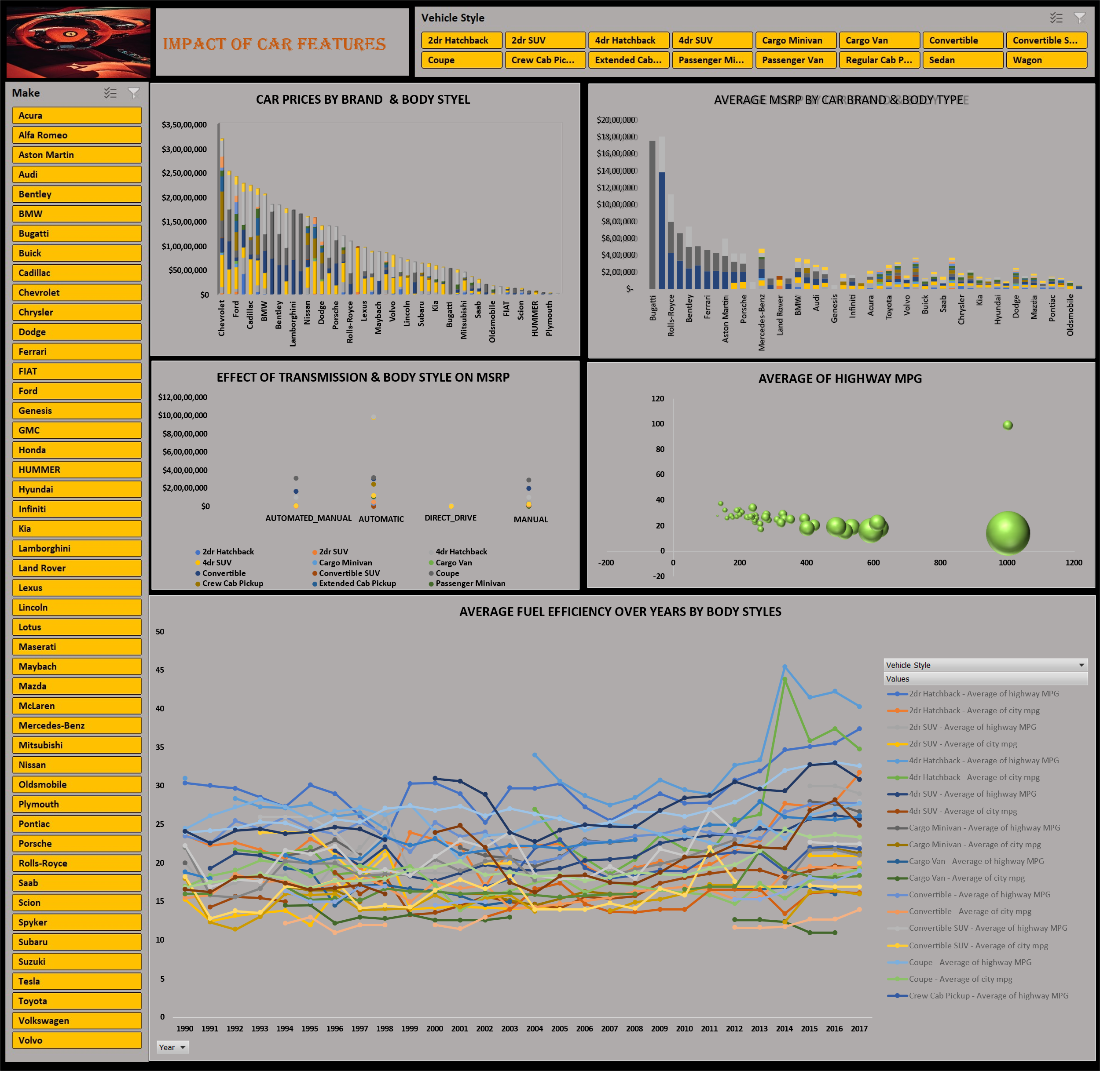

Slide 25

Conclusion
Car prices exhibit significant variations based on brand and body style. Some brands, including Bugatti, Maybach, and Rolls Royce, boast higher average MSRPs than others. The choice of body style similarly impacts the price spectrum, with specific styles commanding higher prices.
Engine power, measured in horsepower, plays a pivotal role in determining car prices. Cars with higher horsepower generally come with higher average costs, indicating that customers are willing to pay a premium for enhanced engine performance.
The analysis underscores the relative significance of various car features in influencing prices. Engine cylinder count, MPG (both city and highway), engine HP, vehicle style, and fuel type all contribute to the pricing dynamics of cars. Understanding these factors is crucial for car manufacturers in setting competitive prices and meeting customer demands effectively.
Furthermore, the analysis unveils variations in fuel efficiency across different body styles and model years. While overall fuel efficiency has improved, differences persist among various body styles over time. This information serves as a valuable guide for car buyers, assisting them in making informed choices by selecting more fuel-efficient options.

Slide 26
Thank You

